Slide 1
September 17th 2019
Notes:
Welcome slide

Slide 2
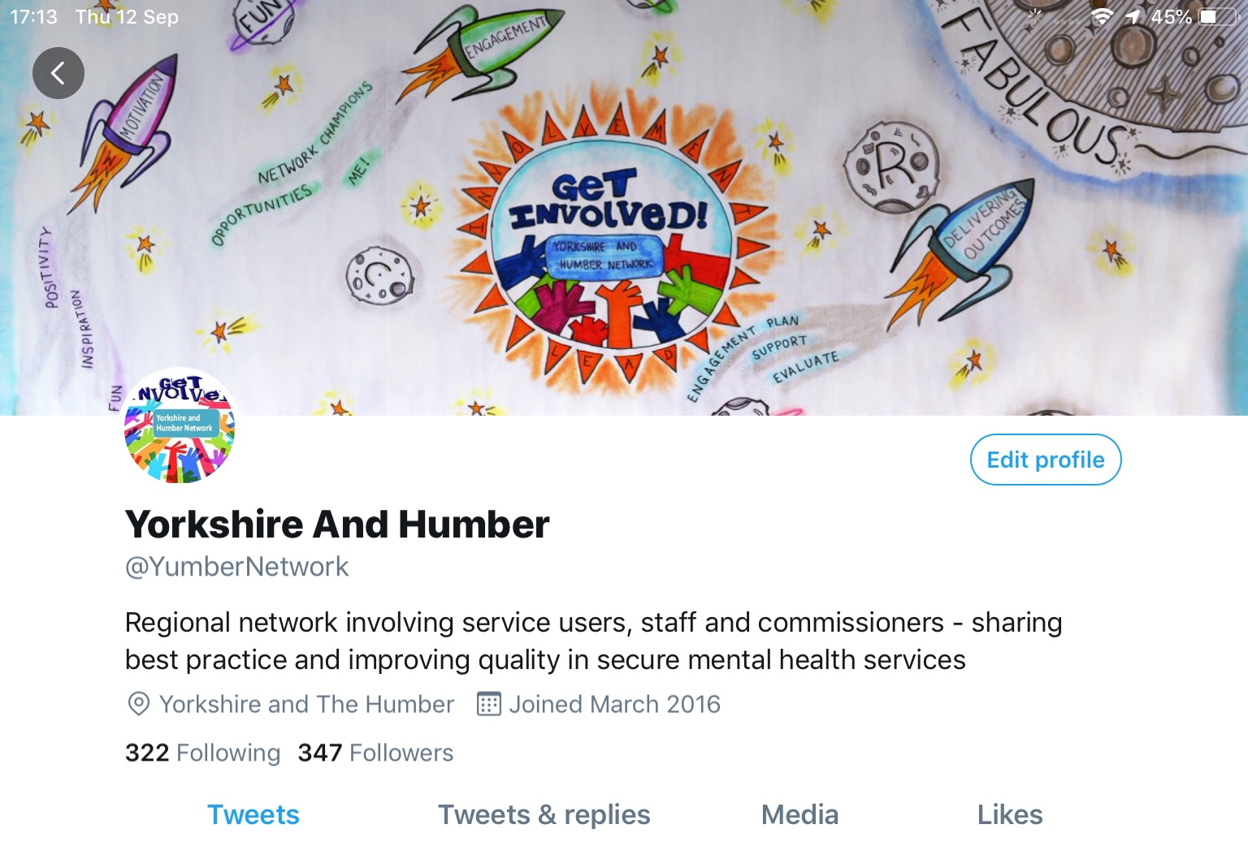

Slide 4
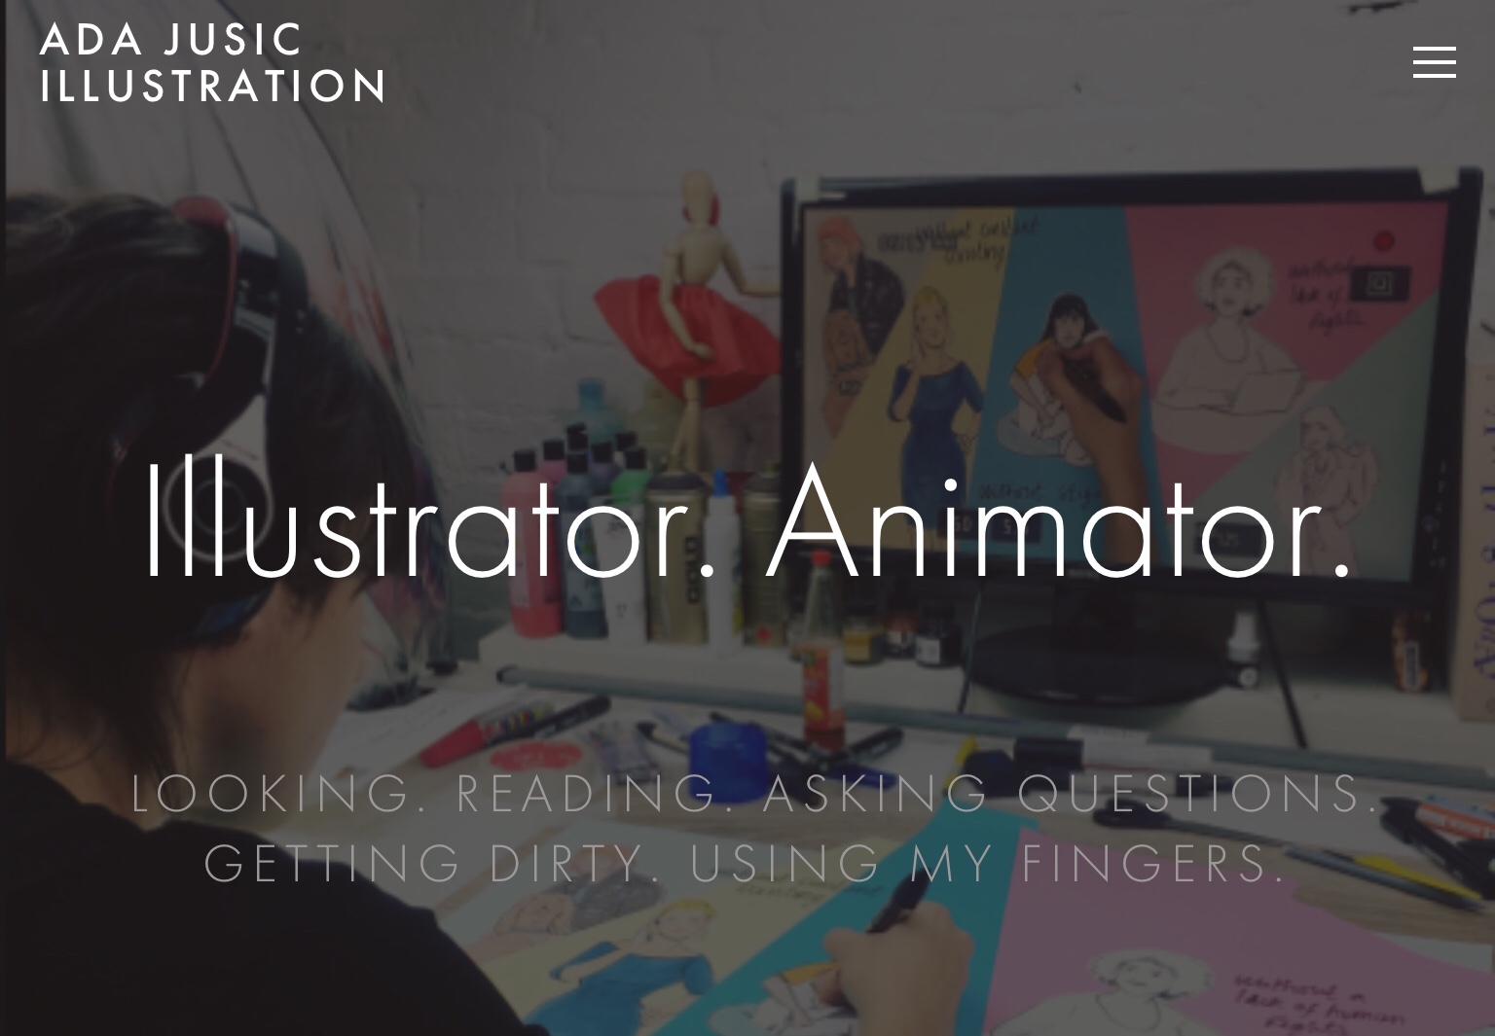

Slide 5
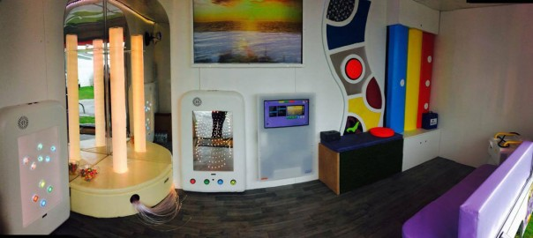
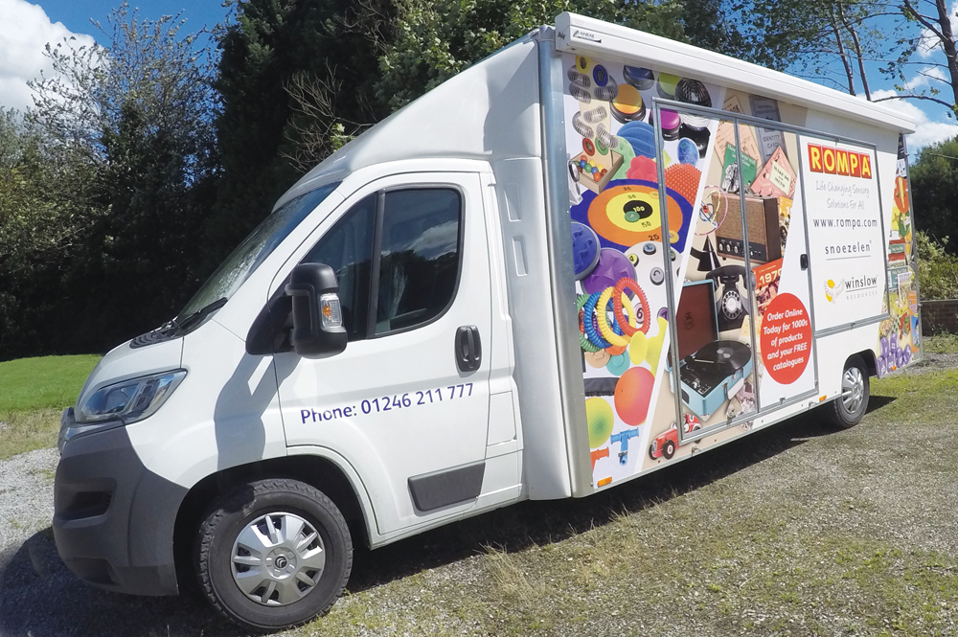
The bus contains all the typical components of a normal Rompa sensory room but this one is installed in a large vehicle that goes to shows and events up and down the country. The sensory bus has:
Rainbow bumpers
A tactile wall
A sensory room projector
A waterless bubble tube
An aroma panel
An interactive floor
An infinity and beyond panel
A colour changing panel
Fibre Optics

Slide 6
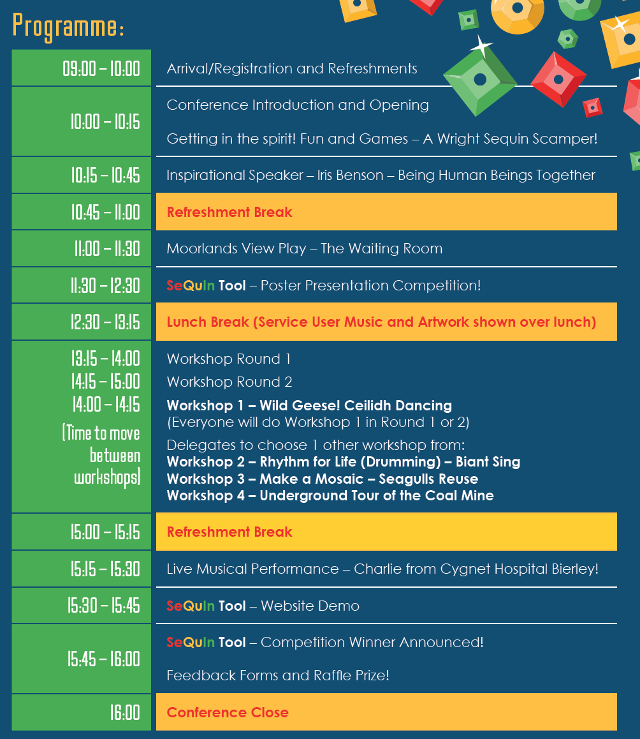

Slide 7
SELFIE FRAME!!
Filming and photography

Slide 8
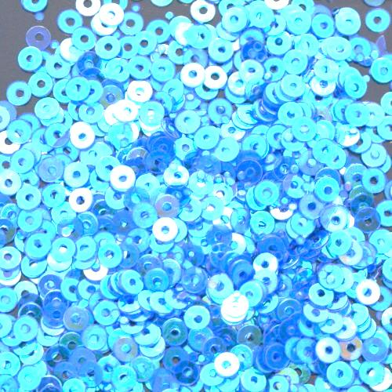
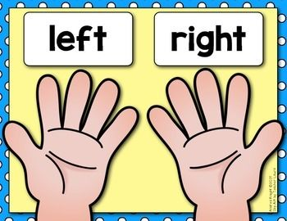
A WRIGHT SeQuIn SCAMPER!

Slide 10
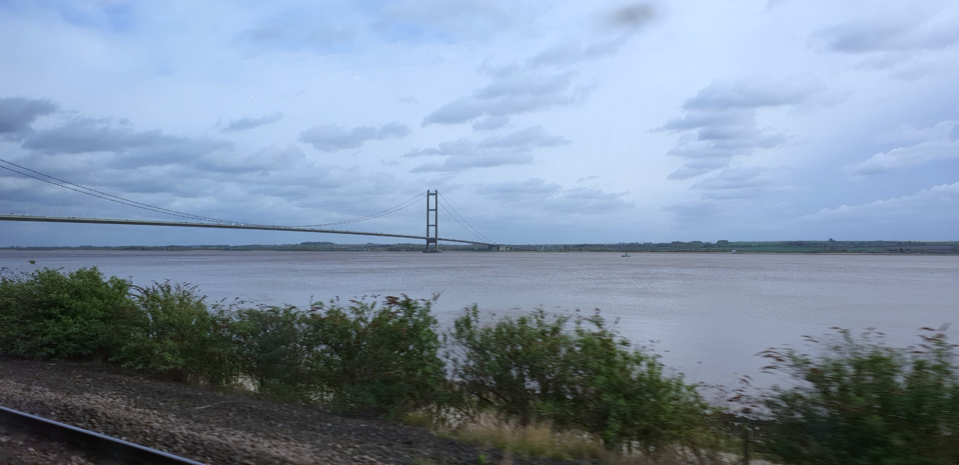
Iris Benson MBE
I am me…. my personal journey.
Presented by Iris Benson MBE…
Copyright © June 2018 ExE Consultant Services & Iris Benson MBE

Slide 11
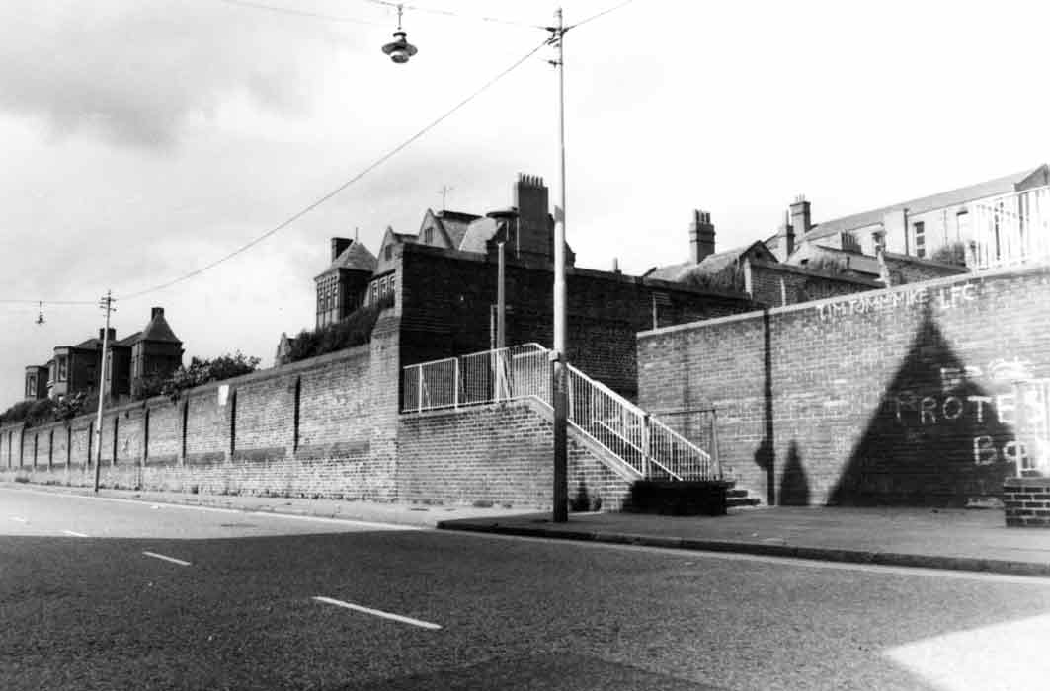
John-Bagot Hospital, Everton.
Copyright © April 2018 ExE Consultant Services & Iris Benson MBE

Slide 12
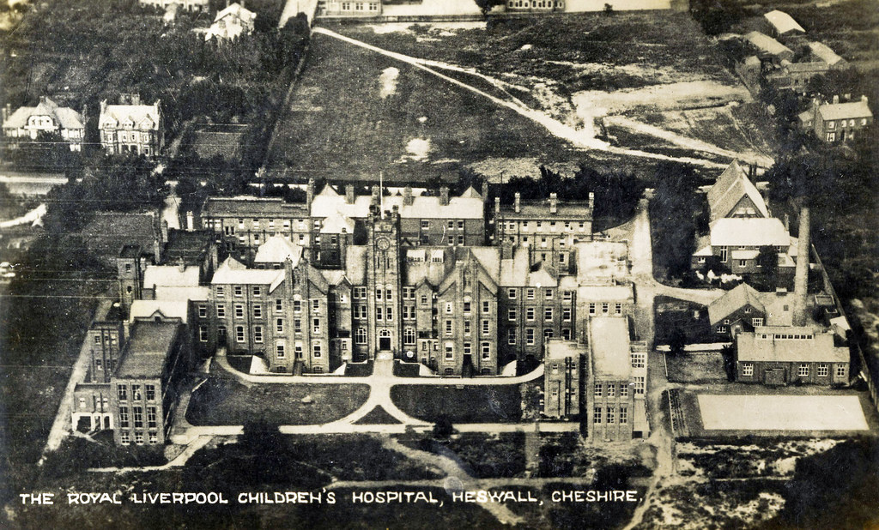
Royal Liverpool Children’s Hospital, Heswall.
Copyright © April 2018 ExE Consultant Services & Iris Benson MBE

Slide 13
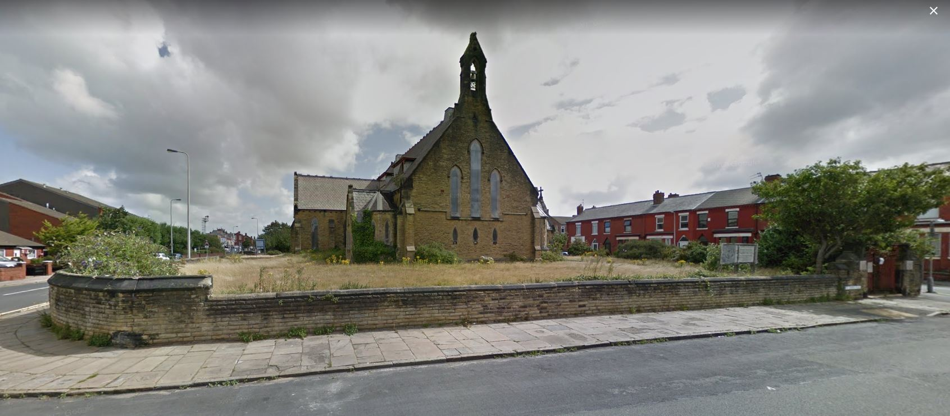
St John’s Church, Waterloo.
Copyright © April 2018 ExE Consultant Services & Iris Benson MBE

Slide 14
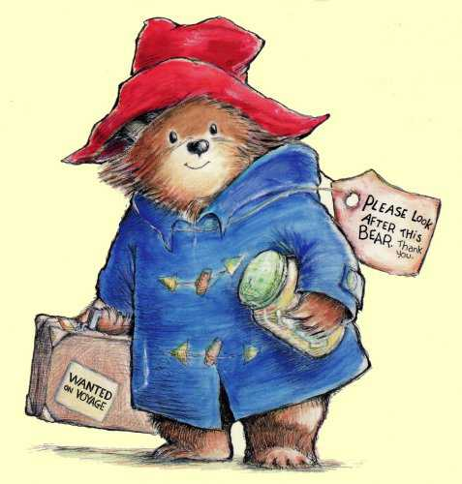
I am that little girl again…
Copyright © April 2018 ExE Consultant Services & Iris Benson MBE

Slide 15
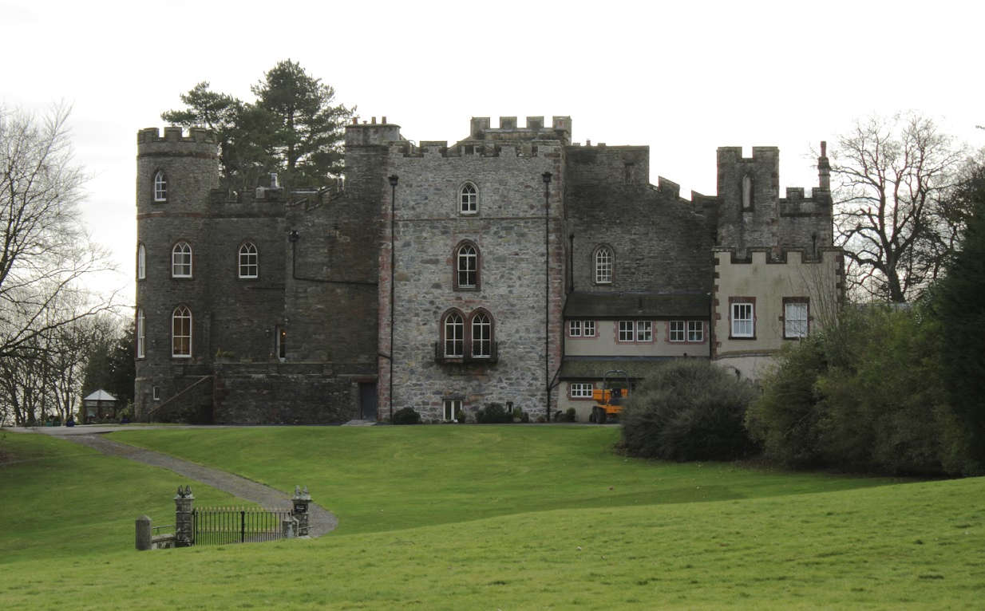
Broughton Towers Special School, Barrow-in-Furness.
Copyright © April 2018 ExE Consultant Services & Iris Benson MBE

Slide 16
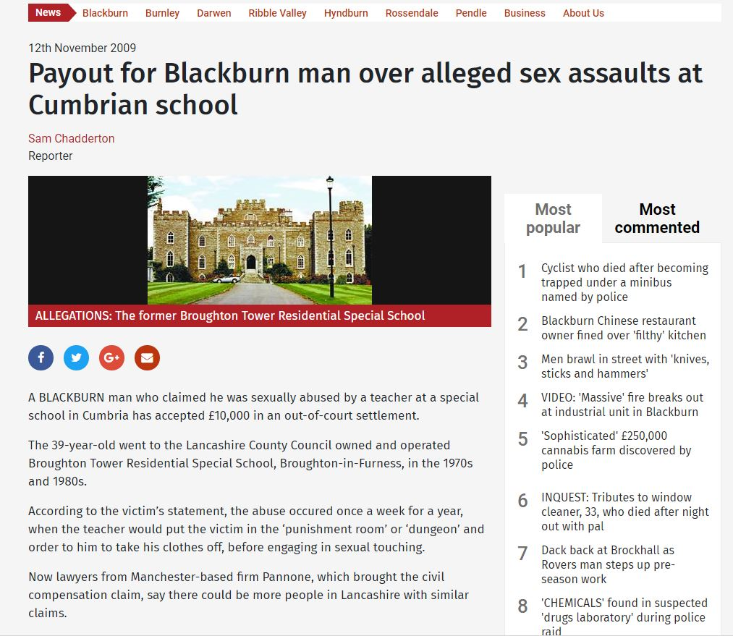
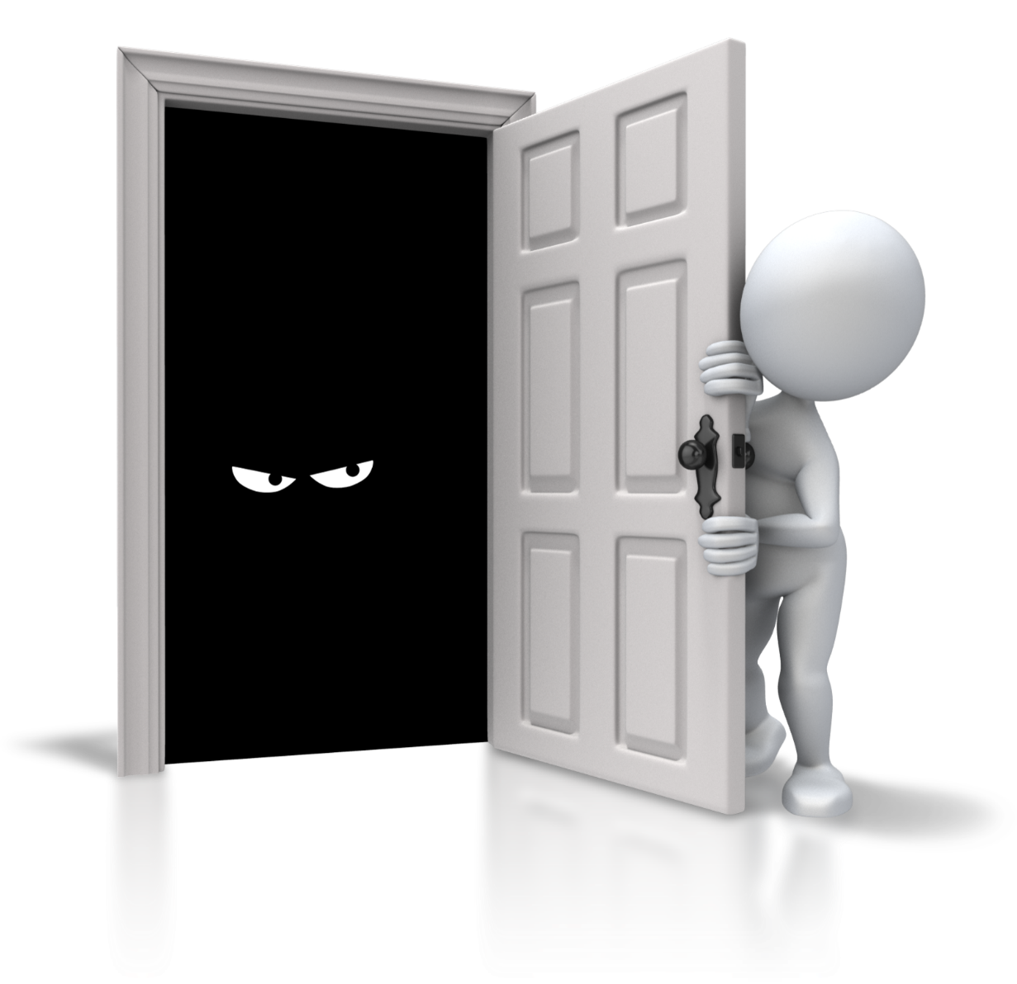
Broughton Towers Special School, Barrow-in-Furness.
Copyright © April 2018 ExE Consultant Services & Iris Benson MBE

Slide 17
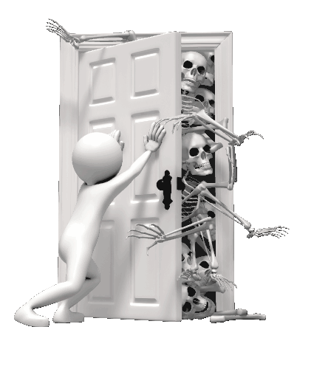
Copyright © April 2018 ExE Consultant Services & Iris Benson MBE

Slide 18
I am that little girl again
Iris Benson MBE
Safe inside my corner, drawn onto the floor.
Huddled in a corner, curled up in a ball.
Trying to be invisible not wanting to be heard,
Tiny little girl,
don't cry anymore.
You’re safe inside your circle.
Drawn onto the the floor.
Copyright © April 2018 ExE Consultant Services & Iris Benson MBE

Slide 19
I am that little girl again
Copyright © April 2018 ExE Consultant Services & Iris Benson MBE

Slide 20
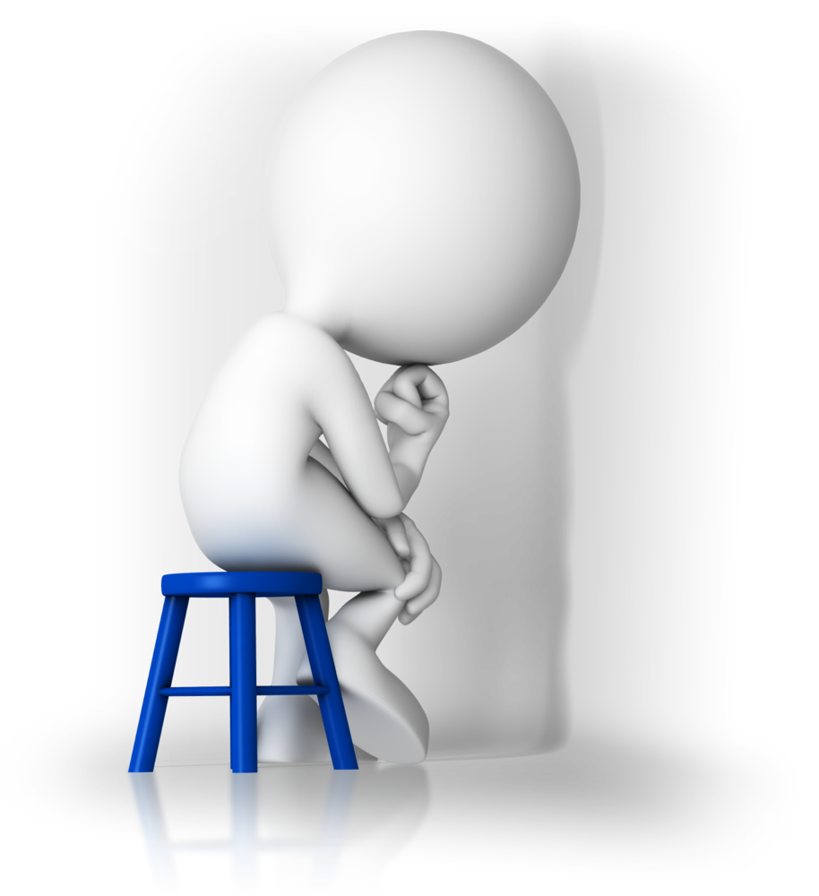
Your words, attitudes and actions,
Impact my life, more than my disability.
www.disabilityisnatural.com
I choose not to place Dis “in my ability” Robert M Hensel
My Disability has opened my eyes to see my true Abilities
Robert M Hensel
If you can do just one thing well, you’re needed by someone. Martina Navratilova
Be careful with your words, Once they are said, They can only be forgiven Not Forgotten.
Carl Sandburg
Don’t mix bad words, with your bad mood.
You will have many opportunities to change a mood, but you will never get the opportunity
To replace the words you spoke.
Lessonslearnsinlife.com
Copyright © April 2018 ExE Consultant Services & Iris Benson MBE

Slide 21
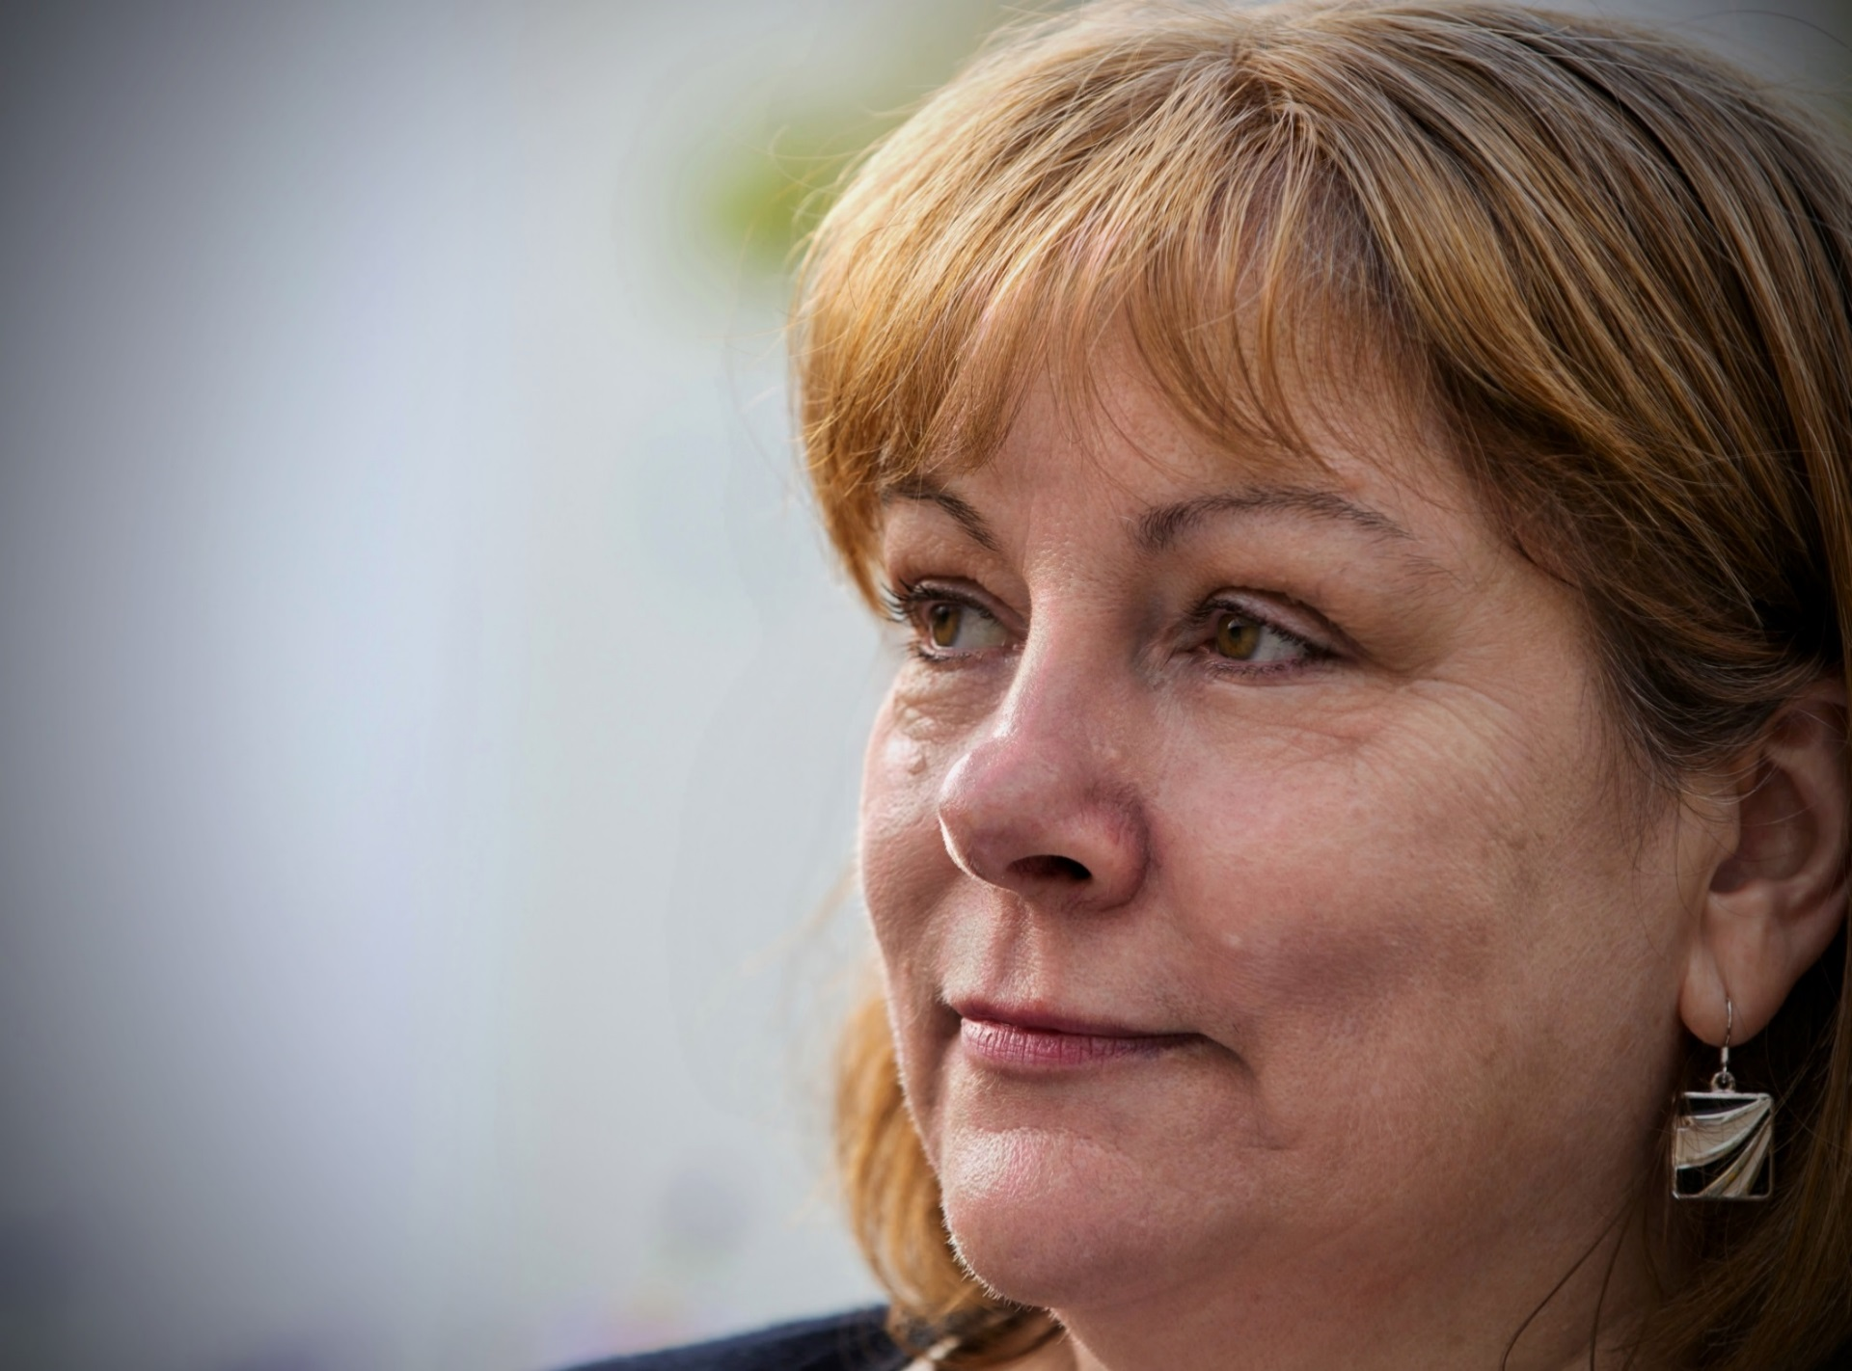
“Perceptions of mental health have changed in my lifetime but there is still a long way to go.”
Iris Benson MBE
Mersey Care expert by experience
Copyright © April 2018 ExE Consultant Services & Iris Benson MBE

Slide 22
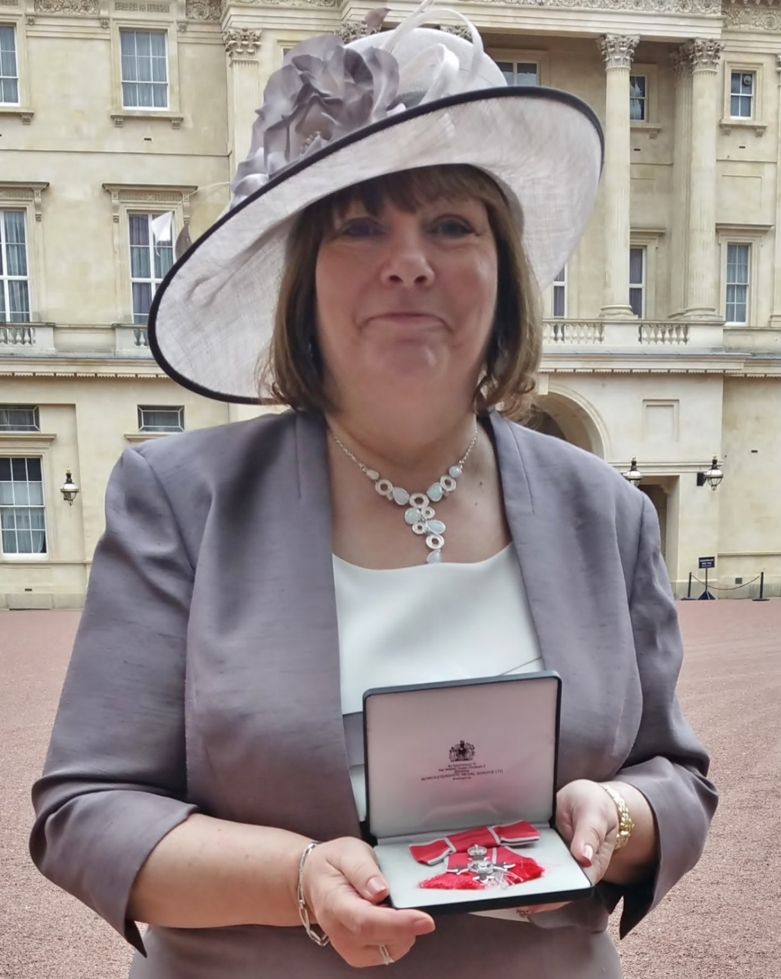
Copyright © April 2018 ExE Consultant Services & Iris Benson MBE

Slide 23
In a Blink of an Eye
In a Blink of an Eye or a sigh, or a breath you can change from the past, to a smile for today.
In a Blink on an Eye the words that we speak, will be soft and keep us safe. Safe from the past that has caused so much hurt. In the Blink of an Eye or a sigh.
You are the future, the change from the past, to today, to be different. No Control, No Restraint, in the blink of an eye not a sigh.
No more pain, just be kind, take the time, make it different from the past, make the change last, in the blink of an eye or a sigh.
Iris Benson MBE
Copyright © April 2018 ExE Consultant Services & Iris Benson MBE
Notes:
IRIS Poem to close: In the blink of an eye.

Slide 24
Words can hurt or heal…
Copyright © April 2018 ExE Consultant Services & Iris Benson MBE
Notes:
Supporting Safewards an it’s positive impact on the wards.

Slide 26
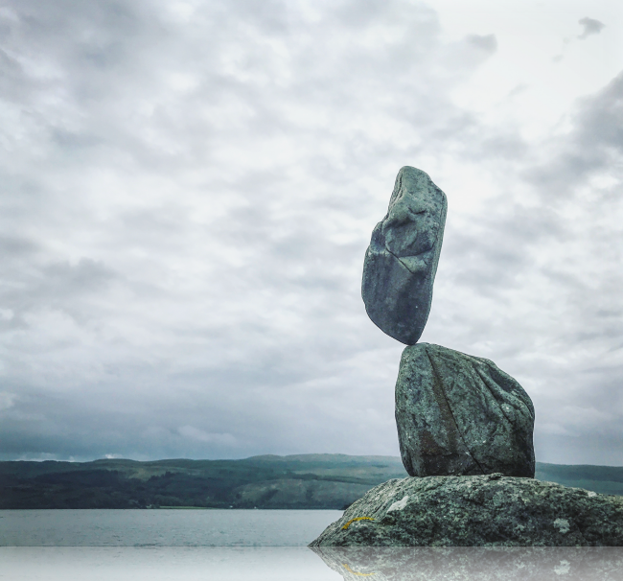
@restoryedsos

Slide 27
SeQuIn Tool
Developed by the Involvement Network – Review and measure involvement.
Developed collaboratively
There are 12 areas – CQUIN’s plus few extra!
Extra funding from In Mind – accessible, website, and UCLAN
Piloted and refined by you!
Quality Network LSU and MSU standards
Measuring your service against others – is it effective?
More info later! Website and SeQuIn Tool

Slide 31
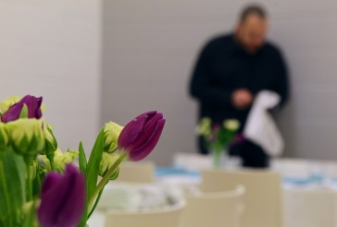
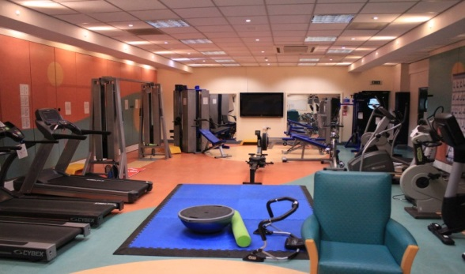
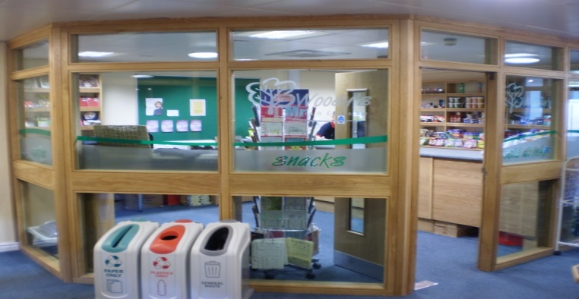
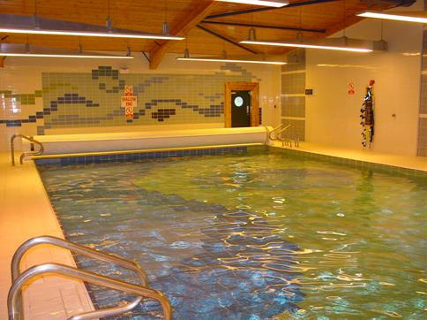
Healthy lifestyles (Minds and Body) Wathwood Hospital Recovery Pathway Standards
Gym /Swimming
Yoga/Dietician
Healthy lifestyles clinic
Charity cycling
Sponsored walk
Woody’s
Self catering
Vocational jobs Horticulture
Sec 17, community
Ass, CC, Rehab, Lodges
Notes:
Wathwood – Recovery Pathway

Slide 32
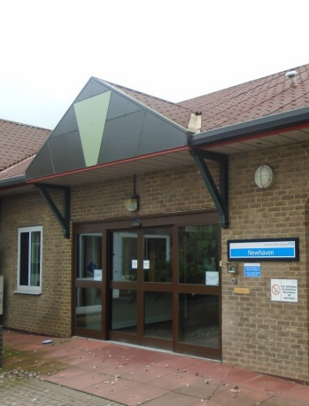
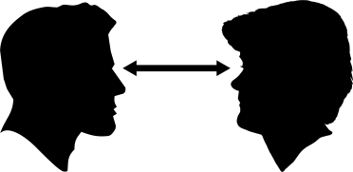
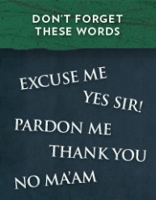
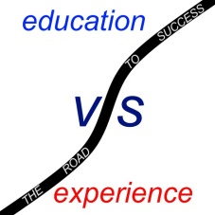
Newhaven Needs You
Hello my names Bob
Congratulations on your new job !
Notes:
Newhaven – Recruitment and Selection

Slide 33
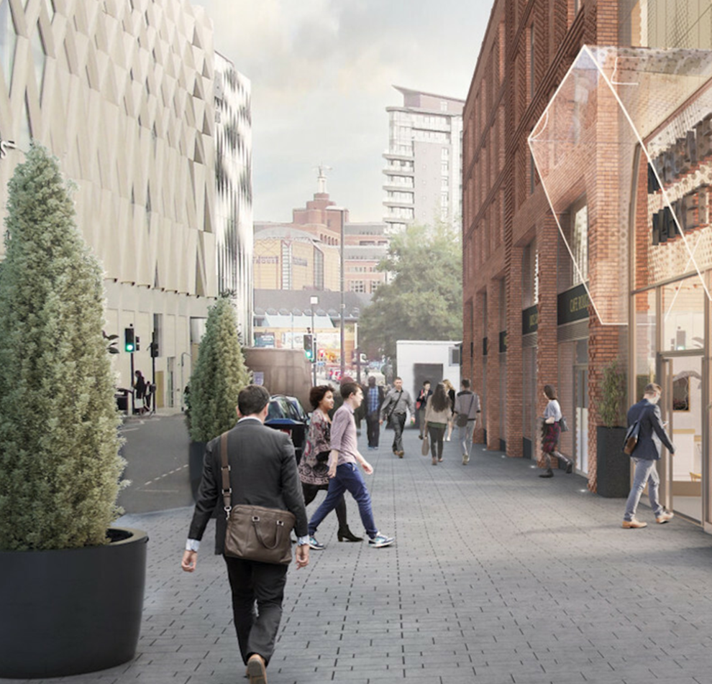
TRACK LIST:
1. Risk assessed together
2. Individually Restrict me
3. I own my Risk
4. Risk discussed wi t’ Recovery
5. Plan so I can, understand!
6. I’ll train you up before I go go
7. Risk Sharing- MDT CPA CTR
8. Risk reviewed and improved
9. Carers talk about Risk
10. My Ward
music
SeQuIn Tool
Available in all good
services now
#RISKISALLAROUND
Notes:
Waterloo Manor – Shared Risk Assessment

Slide 34
Notes:
Cheswold Park – Dining experience and healthy weight

Slide 35
Cheswold Park – Dining Experience and Healthy Weight
Your vote!!
1 | 2
3 | 4
5 | 6
7 | 8
9 | 10
Notes:
Newsam Centre – Recovery Pathway

Slide 36
Aids Recovery
Has Purpose
Enjoyable
CARERS
Enjoyable
Has Purpose
Aids Recovery
Notes:
Bretton Centre – Recovery College

Slide 37
WISH is the only national women’s user-led mental health charity, supporting women & girls who are detained and giving them a voice.
Women
In
Secure
Hospitals.
Independent Advocacy Service
Rachel regularly attends coffee mornings as a more informative way of talking to the women about any issues they have. She then offers to see any of them individually about more personal matters.
Opinions from service users…
“She’s always very helpful, supportive and reliable and goes the extra mile. She always lets us know when she is not going to be around too”
“She’s really supportive and persistent with getting stuff on the ward sorted, like fixing the washing machine”
“She helped with my application process for a tribunal” … “very helpful and gave good advice”
“She always makes time for us”
Rachel Evans
WISH
“Rachel is nice, helpful and thoughtful”
“Gave me good advice about different areas of Sheffield”
Rachel is an Independent Mental Health Advocate (IMHA) for the women on Spencer Ward.
“When I transferred hospitals, she helped me to get my new glasses when I didn’t know what to do”
Notes:
Cygnet Sheffield - Involvement

Slide 38
MDT WORKING
There is an MDT plan
Someone from my
team will attend the meeting
People will talk to me in a way I can
understand
My carers can be
invited
I can attend the
Whole meeting
if I want to
Someone will take notes which I can keep and talk through afterwards
I can have an advocate present
The advocate is not always available
I can see my reports before the meeting
There are no reports
I am supported to present my views
I know the running order of the MDT meeting in advance
I can do activities while waiting.
There is an Action Plan
Notes:
Clifton House MDT

Slide 39
Carer involvement standards
The service has a strategy for carer engagement developed through use of the ‘carer support and involvement in secure mental health services toolkit’
Carers know how to contact their relative and the hospital, and a named point of contact is provided for this.
Where possible there is a choice of venue for carers visits.
When a patient withdraws consent, general information about the hospital and education about mental ill-health and recovery is still available to carers.
There are carers events and signposting available for carer support including how to access a statutory carers assessment.
Carers are personally invited to care planning meetings.
There are ways that carers can feedback about their experience and the information is used to improve the service.
Carers can visit the hospital and have an understanding of where and how their relative is cared for.
Notes:
Stockton Hall – Carer Involvement

Slide 40
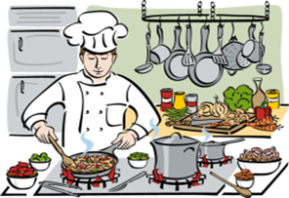
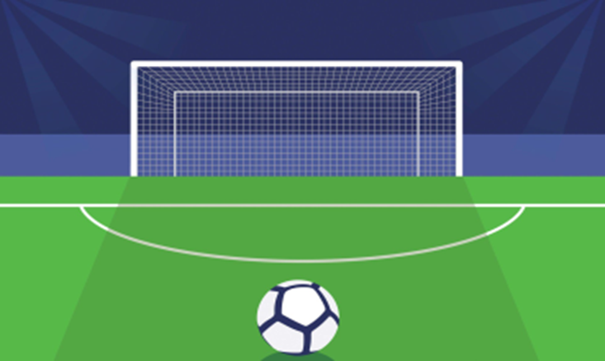
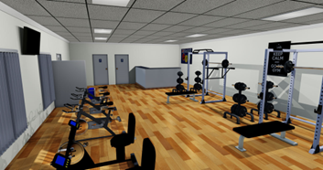
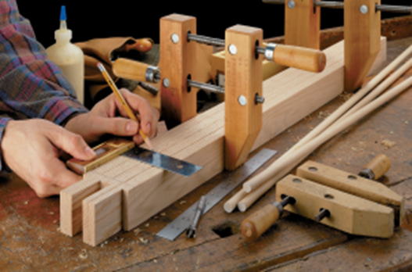
The Humber Centre presents Meaningful Activity Standards
Notes:
Humber Centre – Meaningful Activity

Slide 41
TECHNOL GY
Notes:
Newton Lodge Technology

Slide 42
Well done everyone – winner announced later this afternoon!

Slide 43
Afternoon Workshops
Check your badge to see which workshops to go to
Wild Geese Ceilidh Dancing – Everyone
Rhythm for Life (Drumming)- Biant Singh
Make a Mosaic – Seagulls Reuse
Underground Tour of the Coal Mine

Slide 45
The Wild Geese – formed over 30 years ago in West Yorkshire, the ‘Geese’ entertain pubs, ceilidh dances and functions with traditional and modern Irish songs & tunes mixed with popular music and plenty of craic! They have played throughout the UK, in the USA, Europe and regularly tour the west of Ireland.
Lively, inclusive and very adaptable - the band have played at Bradford District Care NHS Foundation Trust’s “Lynfest” for the last three years.

Slide 47
Charlie
Cygnet Hospital Bierley, Musical Performance
Hello, my name is Charlie. I trained at theatre school from age 4 to 15. I love singing, acting and dancing. I hope you enjoy my performance

Slide 50
Service Name

Slide 51
Service Name

Slide 52
Service Name

Slide 53
Feedback forms - Get your raffle ticket!

Slide 54
Raffle Winner!

Slide 55
Cygnet – our conference sponsors! Laura and Emily!
InMind Healthcare for sponsoring the Tool
Conference Planning Group
– Waterloo Manor
Moorlands View
All our wonderful speakers and workshop facilitators
Tim – music
Charlie – singing!
Ada - illustration!
Waterloo Manor – Table decorations!
Charlotte – Twitter queen
Patrick/ Sam –Website video and filming
Stockton Hall – Photography!
Everyone who sent in their fabulous art work ☺
All of our amazing competition entries!
All of you for your continued support, engagement and enthusiasm for the Network – you all make it Fabulous!

