Slide 2

Managing a Healthy Weight
– Developing the Guidelines
Masterclass – 5th September 2019

Slide 3
A bit of background…
A lot of us have challenges in managing our weight – I do!
In 2016 a report was published by Public Health England that looked at this in secure services
In 2017 we asked people at the Recovery and Outcomes Groups all over the country what they thought about this
www.rethink.org

Slide 4
What did people say?
People told us they would like:
More information in how to stay healthy
More support to improve healthy eating
More activities that helped them stay healthy
More support from all staff
Staff and service user Champions to help them
Examples of ‘what works well’ from different services so they could share ideas
We produced a report called ‘Managing Weight in Secure Services’
You can look at a copy today or we can send you one
www.rethink.org

Slide 5
What did we do?
Over the past year, we’ve been working with NHS England (our commissioners), together with staff, service users and carers – including me and Jo
We’ve been looking at four areas:
Food and nutrition
Physical activity
Treatment interventions
Workforce
We’ve developed some ‘Guidance’ and have collected some examples of what works well in secure services
www.rethink.org

Slide 6
What does the Draft Guidance say?
Here are some examples:
Workforce
All staff are provided with training on physical health through induction and at regular intervals
Where possible training should be co-produced, co-delivered and offered to service users and carers
Staff aim to reduce activities having a food related focus
www.rethink.org

Slide 7
What does the Draft Guidance say?
Food and Nutrition
Service users and carers have a physical health Welcome Pack that includes sections on nutrition and psychology
Service users and carers are provided with information to support them to make healthier choices whilst on section 17 leave
Education sessions and activities for healthy lifestyles and diet are co-produced and available for everyone across the units.
www.rethink.org

Slide 8
What does the Draft Guidance say?
Physical Activity
Welcome pack or video to be co-produced with service users and carers warning of risks of not being active in service, benefits of being active in our service and promotion of opportunities within the service to become active
Making active days part of culture of a ward. Encouraging leisure activities and sports (pool, table tennis, bowls) as light intensity exercise
Encourage ward activities and challenges e.g. charity events ‘rowathon’, walking challenge ‘mile a day my way’, dancing group
www.rethink.org

Slide 9
What does the Draft Guidance say?
Treatment interventions
All patients should be informed about potential physical health issues including weight gain, diabetes and cardio metabolic problems
Medication should be chosen that is less likely to cause weight gain
Before continuing treatment, people’s weight and cardiometabolic profile should be taken into consideration and medication changes made at an early stage if necessary
www.rethink.org

Slide 10
We’d like your help today!
We’ve brought examples of parts of the Draft Guidance today and we’d like your help to tell us:
Is it clear?
Does it make sense?
What do you think of the way it’s written?
Does it cover everything?
What’s missing?
What examples do you have of things that work well in your service?
Write them on the flip charts or on Post-it Notes and put them on the sticky wall!
www.rethink.org

Slide 11
Thank you!
Your help is really appreciated and will make a big difference!
www.rethink.org

Slide 12
Please send your examples to:
Holly and Jo
Or direct to me:
ian.callaghan@rethink.org
Ian Callaghan
Recovery and Secure Care Manager
Rethink Mental Illness
15th Floor
89 Albert Embankment
London
SE1 7TP
www.rethink.org

Slide 13
Feedback on tables:
Please look at each guideline
Then tell us:
Is it clear?
Does it make sense?
What do you think of the way it’s written?
Does it cover everything?
What’s missing?
Anything else you’d like to tell us?
www.rethink.org

Slide 14



Break time

Slide 15
Group Work: Finding Your Solutions
What potential barriers are there to meeting the guidance?
What will help you the most when applying the guidance to your service?
What are your priorities?

Slide 16
Vote: Your Priority Areas
1.
2.
3.
4.
5.
6.
7.
8.
Notes:
<field><classify>1</classify><mode type='0' subtype='1'>1</mode><options>8</options><answer choice='0000000000' weight='0,0,0,0,0,0,0,0' tolerance='TntEdit4'>Edit11</answer><points>10</points><time>60</time><difficulty>1</difficulty><hint></hint><remark></remark></field>

Slide 17



Something Fun!! The Healthy Swaps Quiz

Slide 18

Lunch, Networking & The Sticky Wall
Sticky Wall – Write what already works well for you and your service, and stick it on the wall!

Slide 20
Healthy Weight CQUIN
Overcoming Challenges

Slide 21
What has gone well?
Actively promoting health
Menu changes
Shop changes
Extra physical activity sessions
Increase in specialised staff
Working more collaboratively in MDT and with other hospitals

Slide 22
Challenges
Unhealthy lifestyle has become a norm and hard to change
Resistance to change
Low motivation
Challenges with the shop
Encouraging patients to make healthier options

Slide 23
Overcoming Challenges
Mindfulness and behaviour change group sessions
Health champions on each ward
Monthly health awareness events
Healthy living course for staff and patients
Increase in physical activities available
Physical health patient group

Slide 24
Overcoming Challenges
No junk food in nurses station (out of sight out of mind)
Health promotion posters around hospital
Health added into staff Induction
Alternative items available in the shop
Healthier Options increased

Slide 25


Any Questions?

Slide 26


The Journey So Far
Amber Lodge

Slide 27
Group Work: Your Vision
Think about the following three areas:
Engagement – How we can be involved
Motivation – How will we be motivated to make the changes
Patient experience – what do service users want the service to do

Slide 28
Break time

Slide 29
My view and experiences on leading an healthier lifestyle at CPH
Aiden - Sport & Exercise Assistant at Cheswold Park Hospital

Slide 30
Contents
Bootcamp & Breakfast
CPH Shop
Menu’s
My experiences & what is important to me

Slide 31
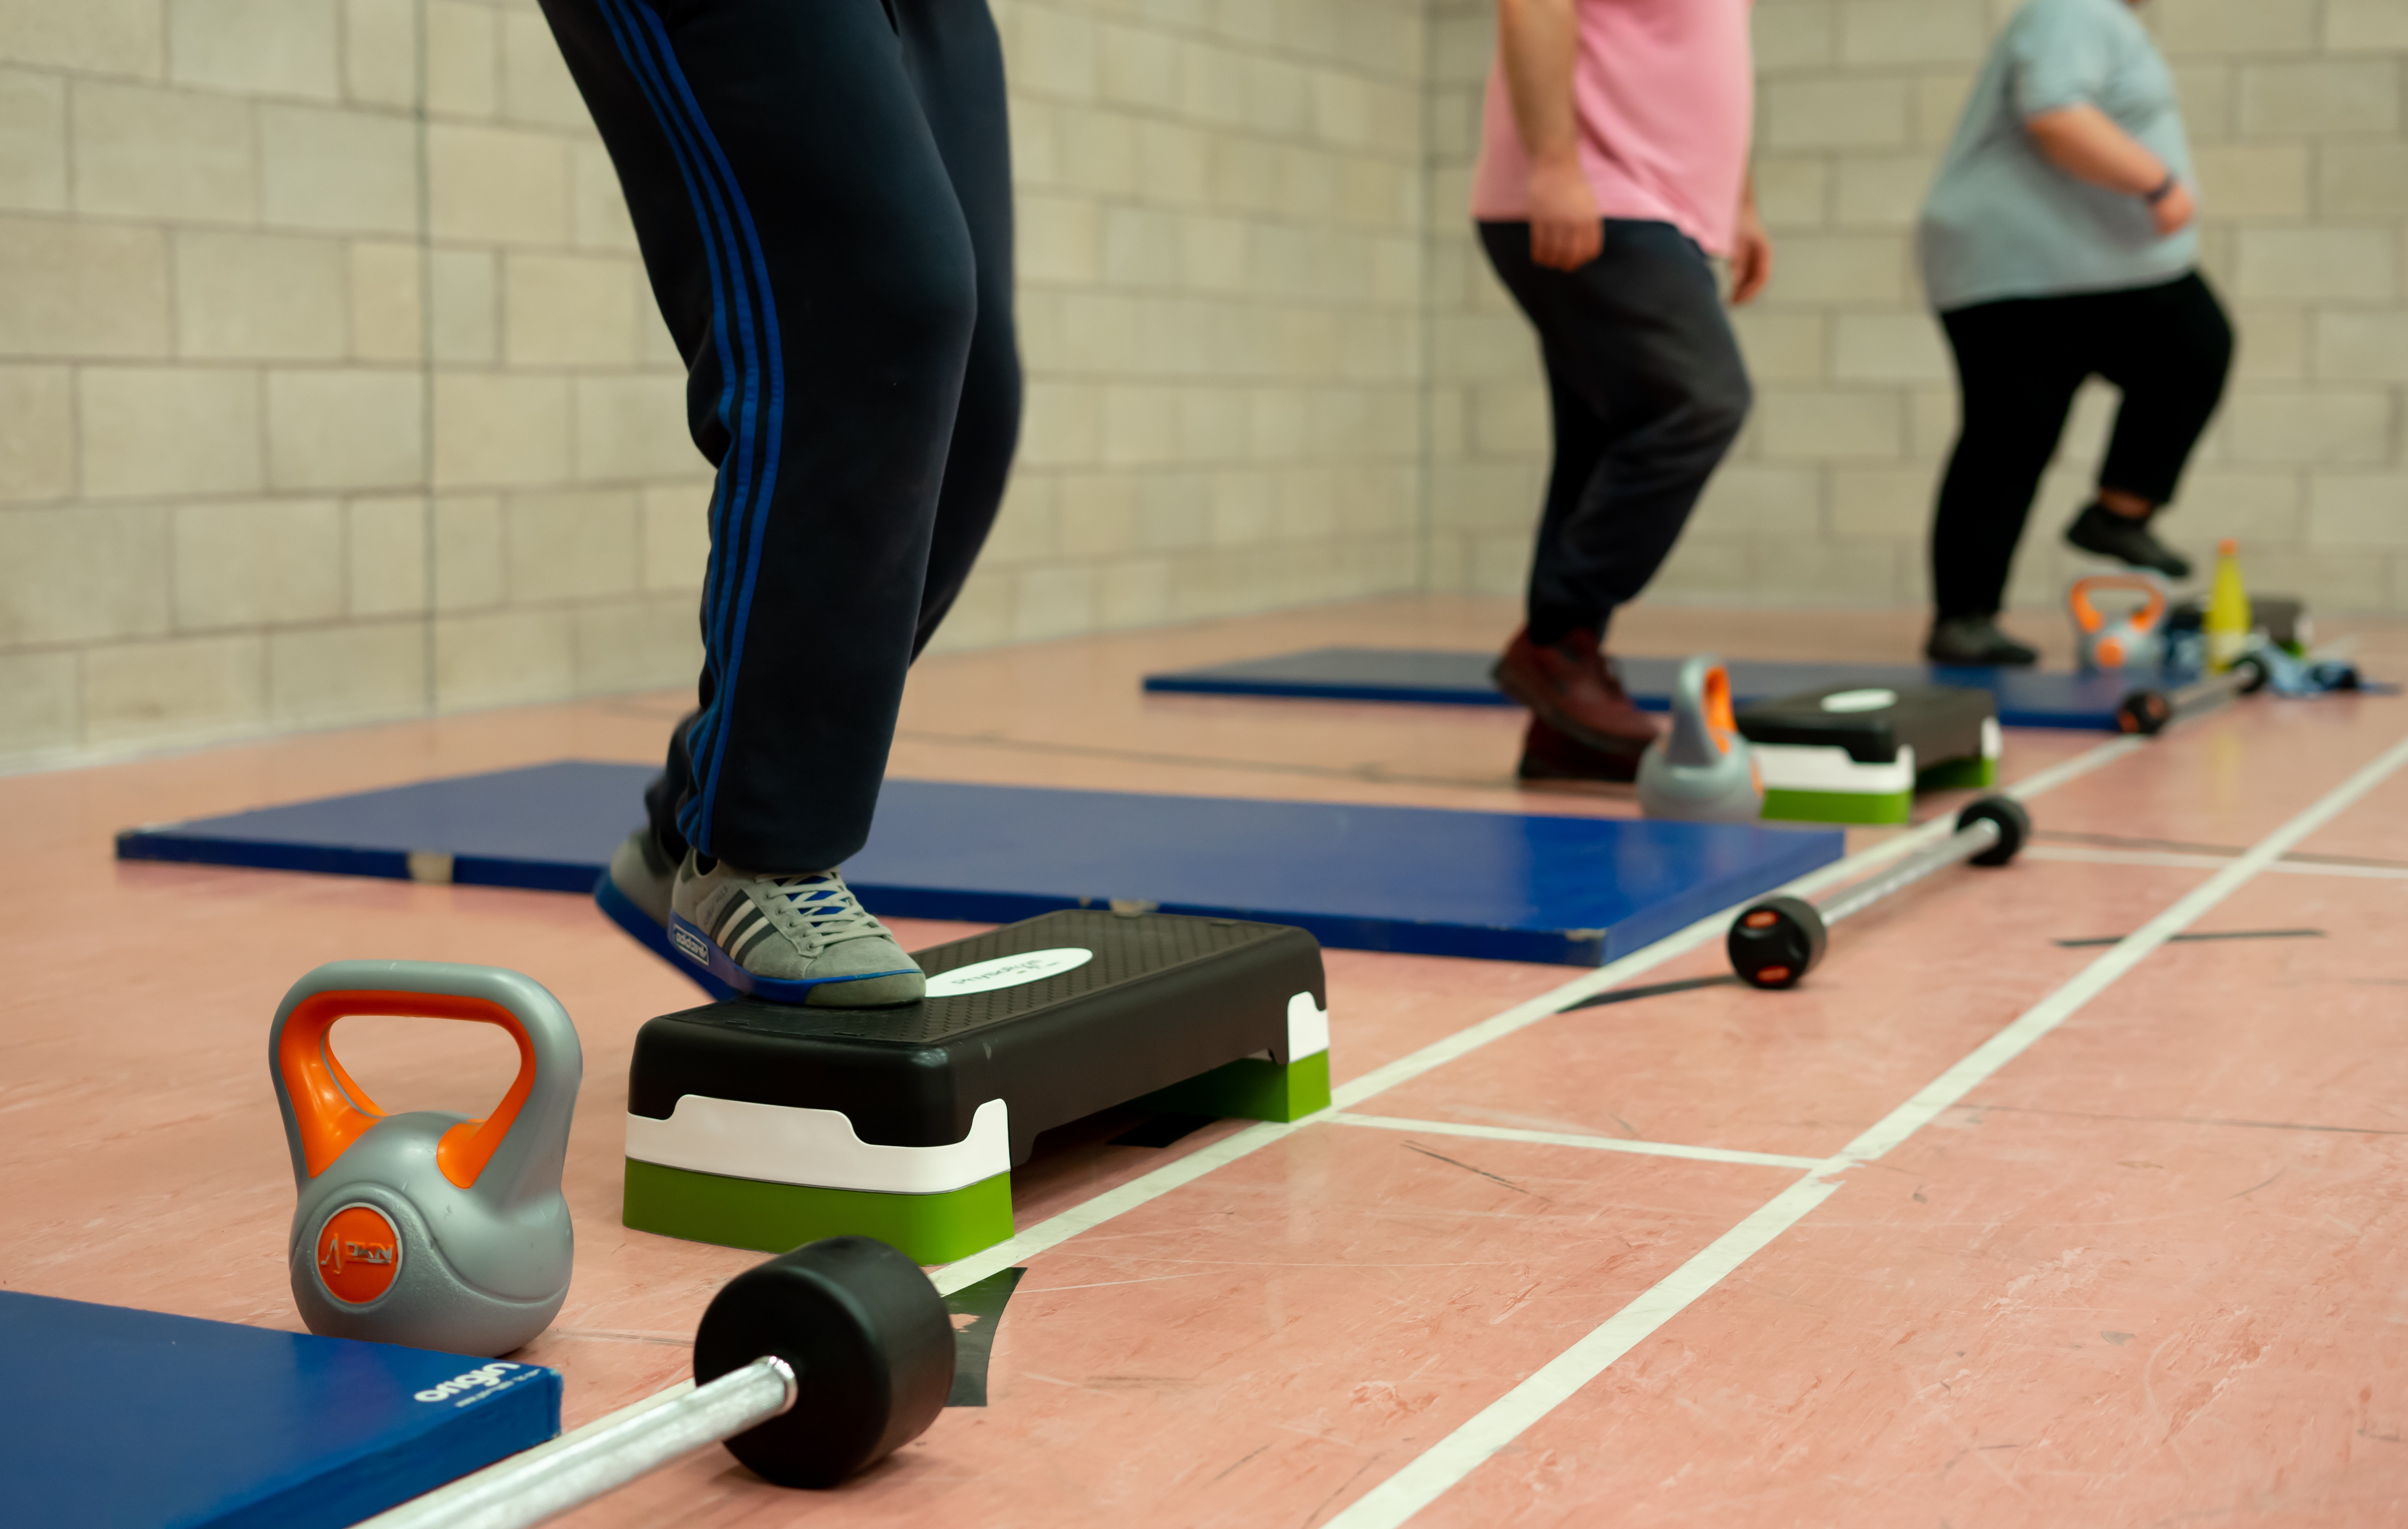
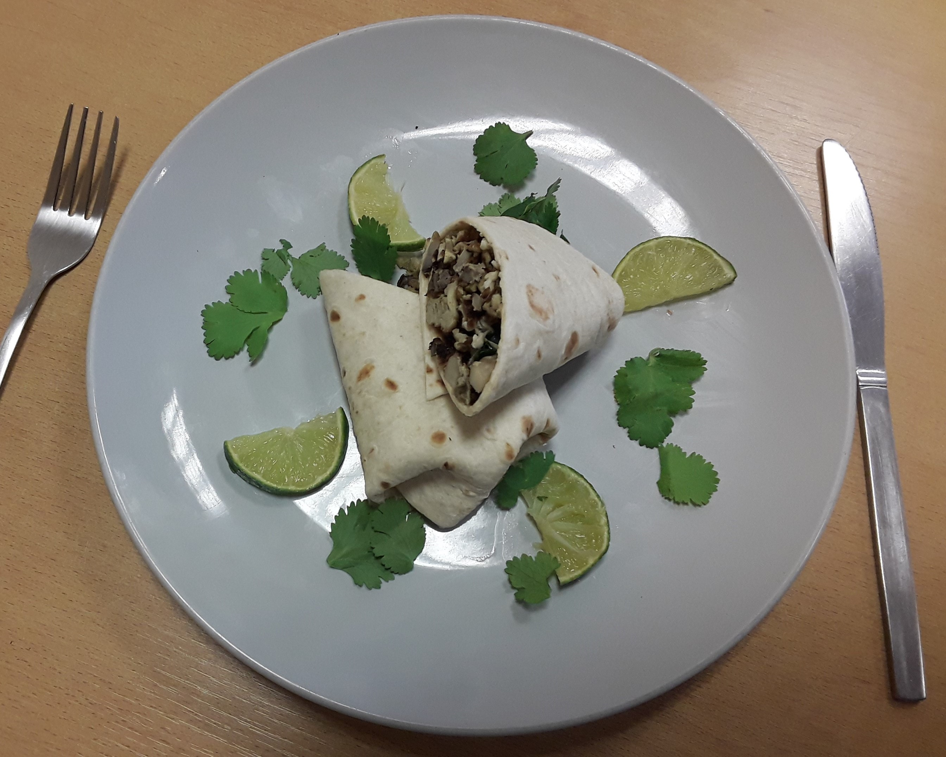
Bootcamp & Breakfast:

Slide 32



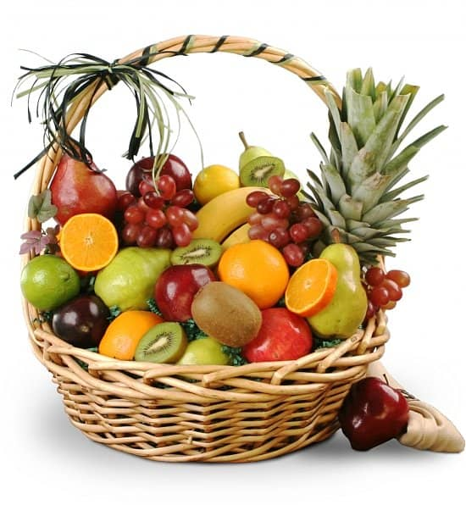
CPH Shop:

Slide 33
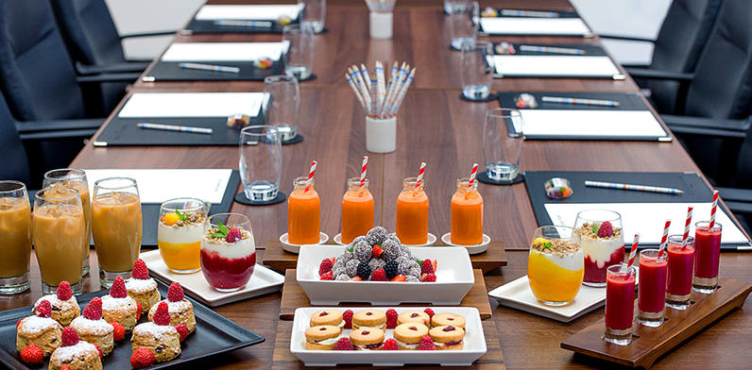
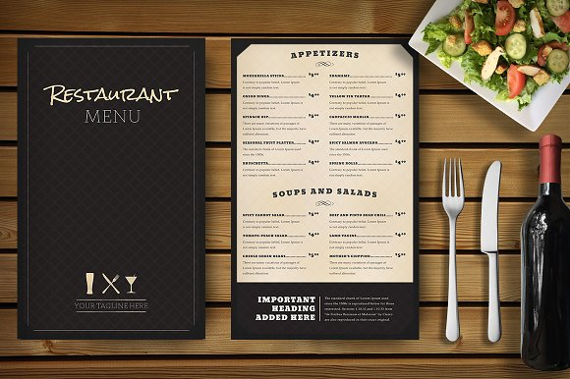

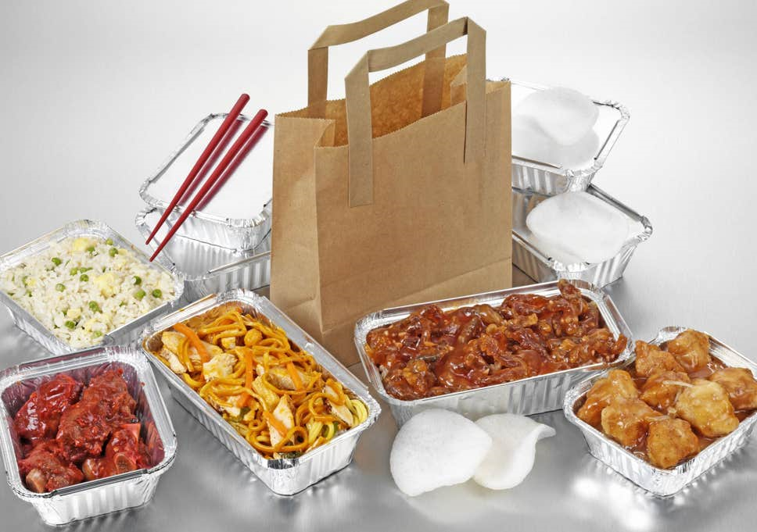
Menu’s

Slide 34
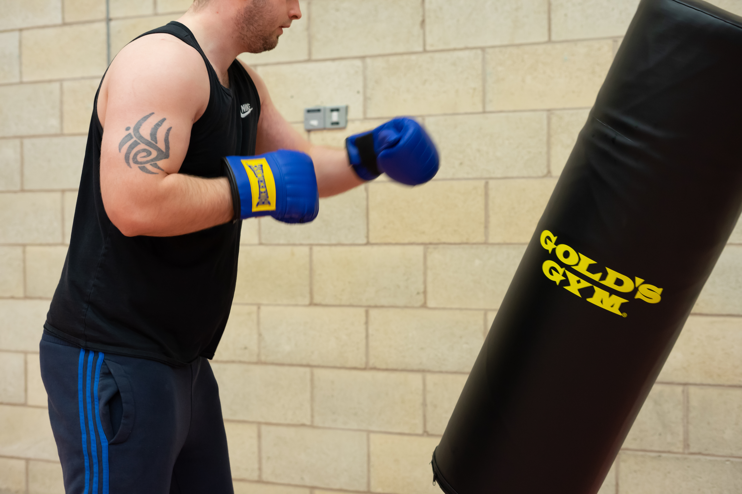
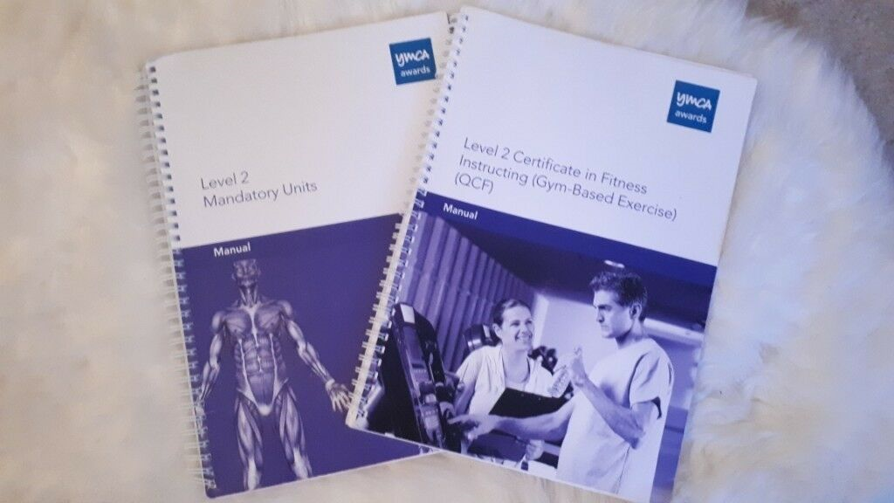

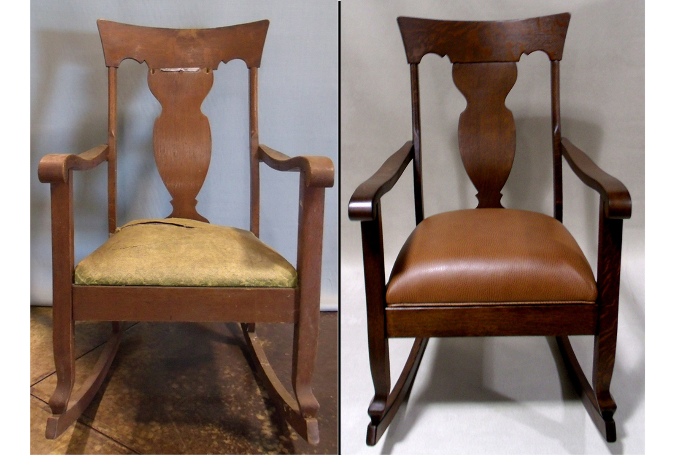

My experiences & what is important to me:

Slide 35
Group Work: Challenges & Solutions
Making it A Reality
What will I be doing differently to find my healthy weight?
How will I know I will have helped someone find their healthy weight?

Slide 36
Making My Plan (with a song)
Let’s listen to the body positivity song
https://www.youtube.com/watch?v=IFKg90qM5xQ
“By December 5th I will have ……………………..”
What’s your motivational song to help you achieve your goal?

